Slide 1
Azure Automated ML Demo
Venky Dahale (DS)
Arpana Brahmbhatt (IE)
Sridhar Kothalanka (CSA)
Mar 2020

Slide 2
Overview
1
2
3
4
What is Azure Automated ML?
Azure Automated Machine Learning (AutoML) focuses on making the entire process of machine learning easy, with the goal of bringing efficiency to data scientists as well as enabling non-data scientists to build models

Slide 3
Aircraft Engine Remaining Useful Life (RUL) Dataset
Dataset Description: Simulated aircraft sensor values to predict when an aircraft engine will fail in the future so that maintenance can be planned, in advance.
Binary classification: Predict if an asset will fail within certain timeframe (e.g., 30 days)
Sample Dataset
id | cycle | setting1 | setting2 | setting3 | s1 | s2 | s3 | s4 | s5 | s6 | s7 | s8 | s9 | s10 | s11 | s12 | s13 | s14 | s15 | s16 | s17 | s18 | s19 | s20 | s21 | label1
1 | 1 | 0.0023 | 3.00E-04 | 100 | 518.67 | 643.02 | 1585.29 | 1398.21 | 14.62 | 21.61 | 553.9 | 2388.04 | 9050.17 | 1.3 | 47.2 | 521.72 | 2388.03 | 8125.55 | 8.4052 | 0.03 | 392 | 2388 | 100 | 38.86 | 23.3735 | 1
1 | 2 | -0.0027 | -3.00E-04 | 100 | 518.67 | 641.71 | 1588.45 | 1395.42 | 14.62 | 21.61 | 554.85 | 2388.01 | 9054.42 | 1.3 | 47.5 | 522.16 | 2388.06 | 8139.62 | 8.3803 | 0.03 | 393 | 2388 | 100 | 39.02 | 23.3916 | 1
2 | 1 | -9.00E-04 | 4.00E-04 | 100 | 518.67 | 642.66 | 1589.3 | 1407.16 | 14.62 | 21.61 | 553.14 | 2388.1 | 9040.2 | 1.3 | 47.43 | 521.62 | 2388.14 | 8129.59 | 8.4283 | 0.03 | 392 | 2388 | 100 | 39 | 23.3923 | 0
2 | 2 | -0.0011 | 2.00E-04 | 100 | 518.67 | 642.51 | 1588.43 | 1405.47 | 14.62 | 21.61 | 553.53 | 2388.07 | 9053.77 | 1.3 | 47.45 | 522.02 | 2388.08 | 8120.05 | 8.4414 | 0.03 | 393 | 2388 | 100 | 38.84 | 23.2902 | 0
3 | 95 | 0.0014 | -2.00E-04 | 100 | 518.67 | 642.95 | 1595.37 | 1408.57 | 14.62 | 21.61 | 553.01 | 2388.1 | 9049.88 | 1.3 | 47.61 | 521 | 2388.16 | 8129.84 | 8.4695 | 0.03 | 393 | 2388 | 100 | 38.78 | 23.1833 | 0
3 | 96 | -0.0017 | -4.00E-04 | 100 | 518.67 | 642.83 | 1588.76 | 1406.08 | 14.62 | 21.61 | 552.93 | 2388.15 | 9053.68 | 1.3 | 47.63 | 521.34 | 2388.18 | 8131.72 | 8.4491 | 0.03 | 394 | 2388 | 100 | 38.77 | 23.3385 | 1
4 | 75 | -7.00E-04 | 5.00E-04 | 100 | 518.67 | 642.85 | 1587.13 | 1413.85 | 14.62 | 21.61 | 553.16 | 2388.07 | 9054.07 | 1.3 | 47.65 | 521.48 | 2388.07 | 8129.5 | 8.4774 | 0.03 | 393 | 2388 | 100 | 38.78 | 23.2761 | 0
4 | 76 | -0.0047 | -4.00E-04 | 100 | 518.67 | 643.11 | 1583.44 | 1408.32 | 14.62 | 21.61 | 552.68 | 2388.13 | 9052.06 | 1.3 | 47.7 | 521.49 | 2388.15 | 8136.24 | 8.4456 | 0.03 | 393 | 2388 | 100 | 38.92 | 23.2351 | 1
5 | 67 | -0.0048 | 1.00E-04 | 100 | 518.67 | 642.58 | 1586.59 | 1410.29 | 14.62 | 21.61 | 553.2 | 2388.1 | 9058.17 | 1.3 | 47.53 | 521.75 | 2388.06 | 8128.16 | 8.4509 | 0.03 | 394 | 2388 | 100 | 38.89 | 23.2904 | 0
5 | 68 | -0.0017 | -2.00E-04 | 100 | 518.67 | 642.9 | 1583.33 | 1413.17 | 14.62 | 21.61 | 553.86 | 2388.13 | 9053.78 | 1.3 | 47.6 | 521.08 | 2388.11 | 8131.52 | 8.432 | 0.03 | 394 | 2388 | 100 | 38.89 | 23.26 | 1
…
100 | 167 | 0.0011 | 1.00E-04 | 100 | 518.67 | 642.66 | 1590.79 | 1412.69 | 14.62 | 21.61 | 553.57 | 2388.04 | 9108.28 | 1.3 | 47.59 | 521.52 | 2388.05 | 8172.7 | 8.4855 | 0.03 | 395 | 2388 | 100 | 38.93 | 23.3488 | 0
100 | 168 | -0.001 | 1.00E-04 | 100 | 518.67 | 642.94 | 1585.16 | 1406.95 | 14.62 | 21.61 | 553.81 | 2388.04 | 9099.31 | 1.3 | 47.47 | 521.65 | 2388.07 | 8181.49 | 8.452 | 0.03 | 393 | 2388 | 100 | 38.97 | 23.3224 | 1
Mapping to Bell sampleProcessData.xlsx
Column Name | Description | Bell sampleprocessdata.xlsx (guessing the mapping)
Id | Aircraft engine identifier, range [1,100] | Machine Id
Cycle | Time, in cycles | Date, Timestamp, Load Code
Setting 1, 2, 3 | Operational settings (settings1 – settings3) | Setpoint e.g., “Nitrogen Setpoint”
s1 – s21 | Sensor measurement (s1 – s21) | Present Value e.g., “Nitrogen PV”
label1 | Ground truth - maintenance required in 30 days (1) | <not available>

Slide 4
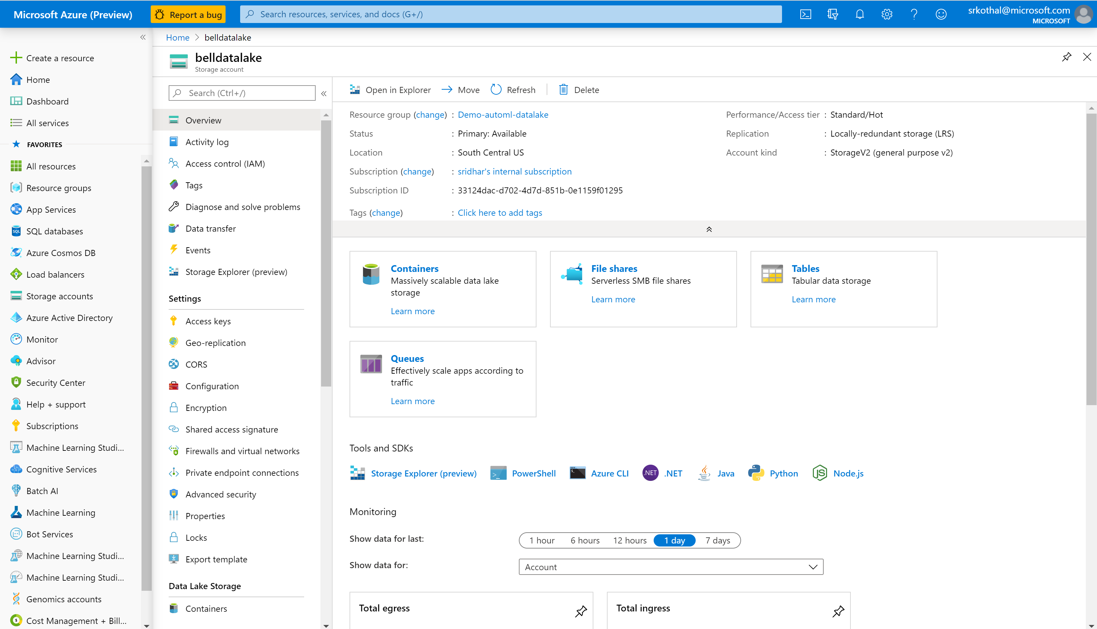
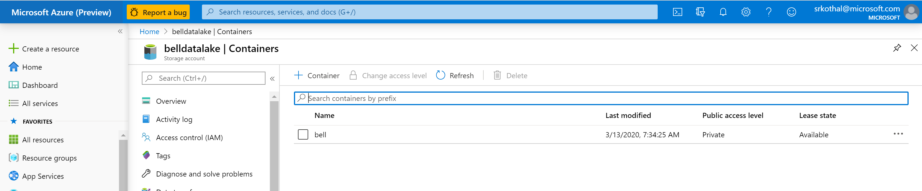
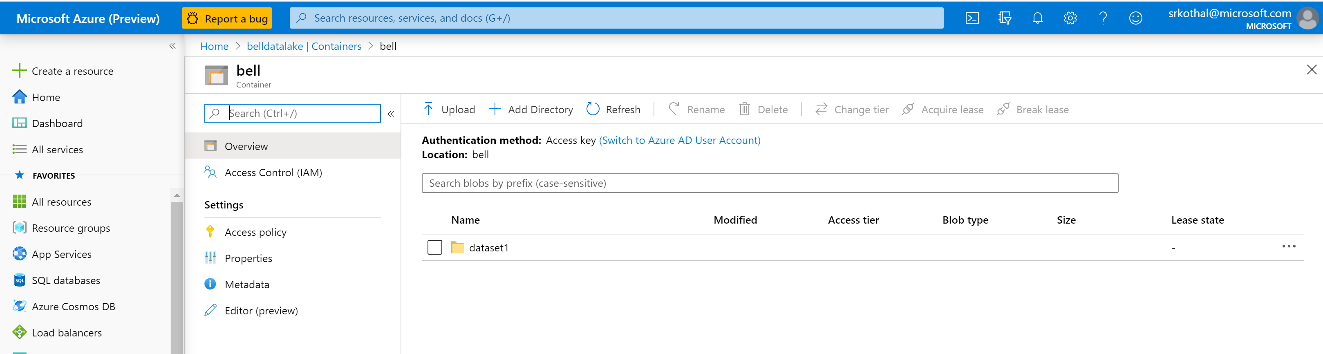
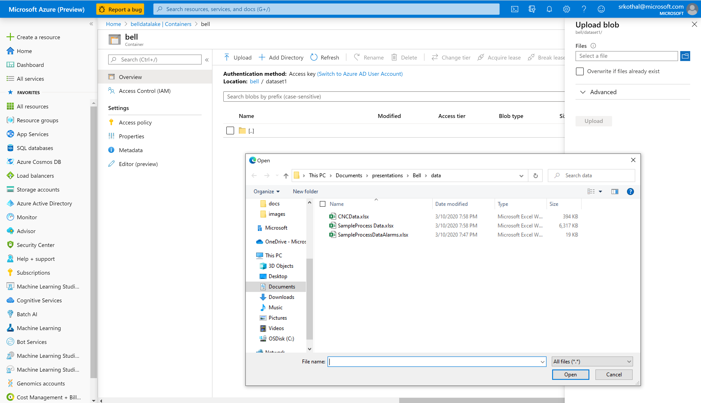
Create an ADLS-Gen2 resource and initialize it
1
2
3
4

Slide 5
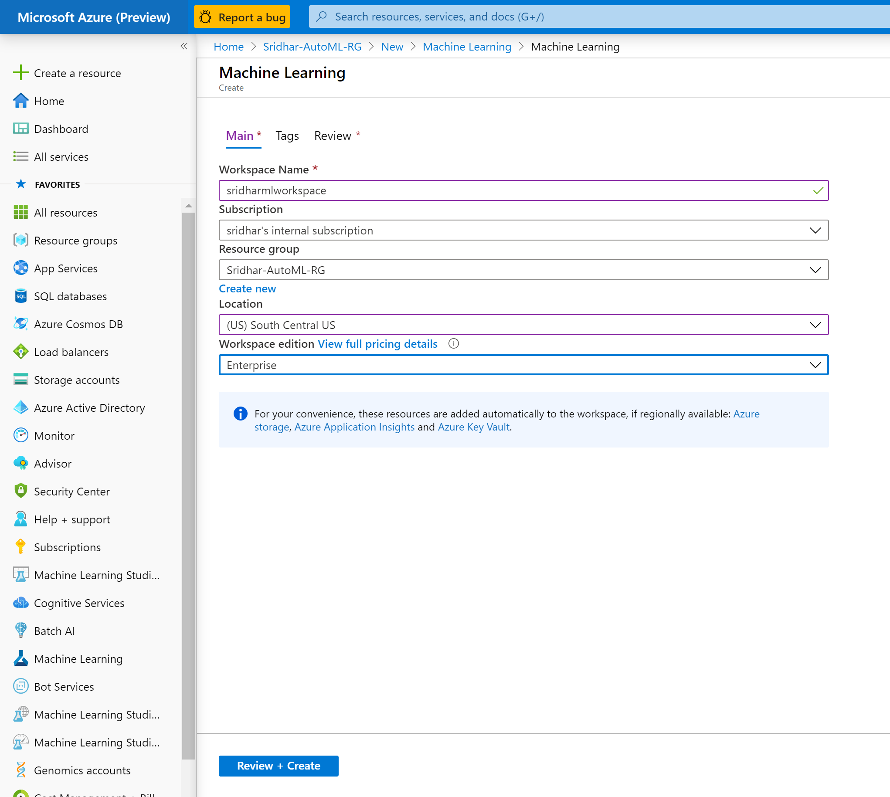
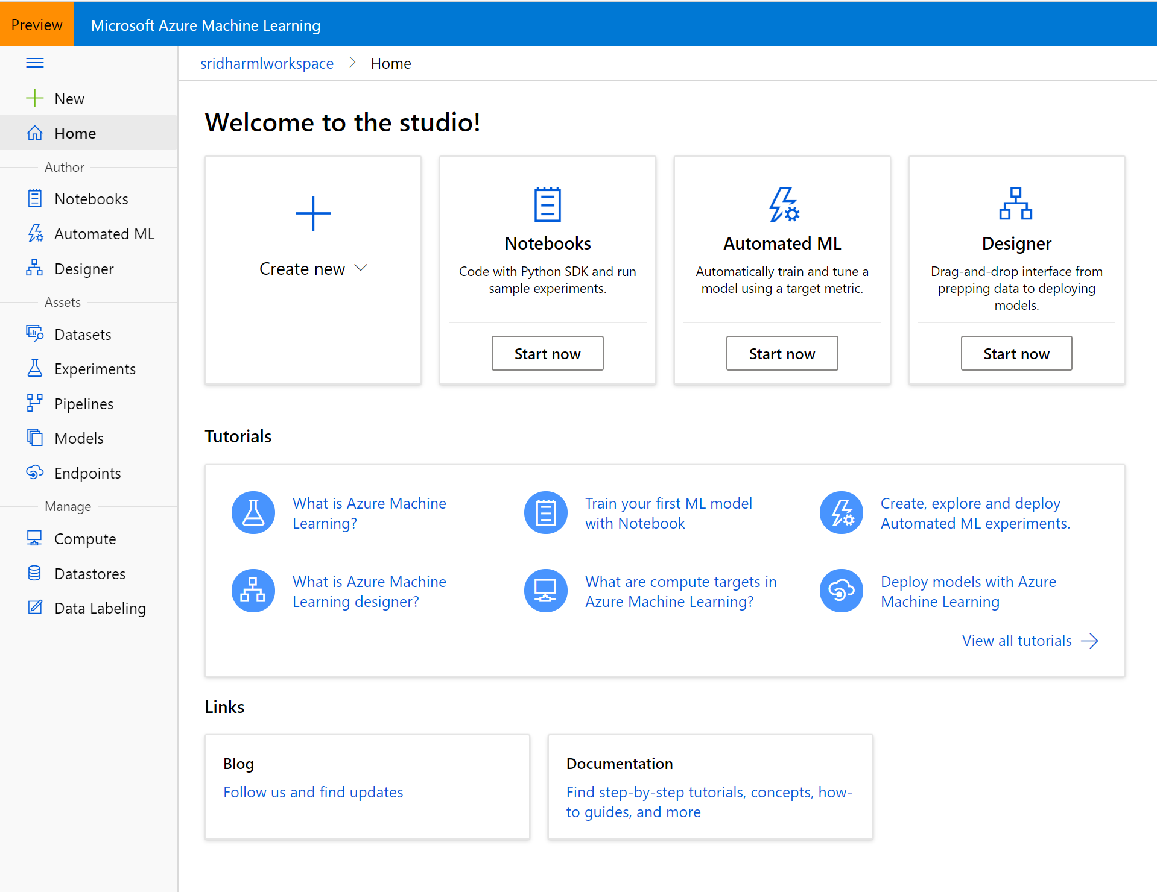
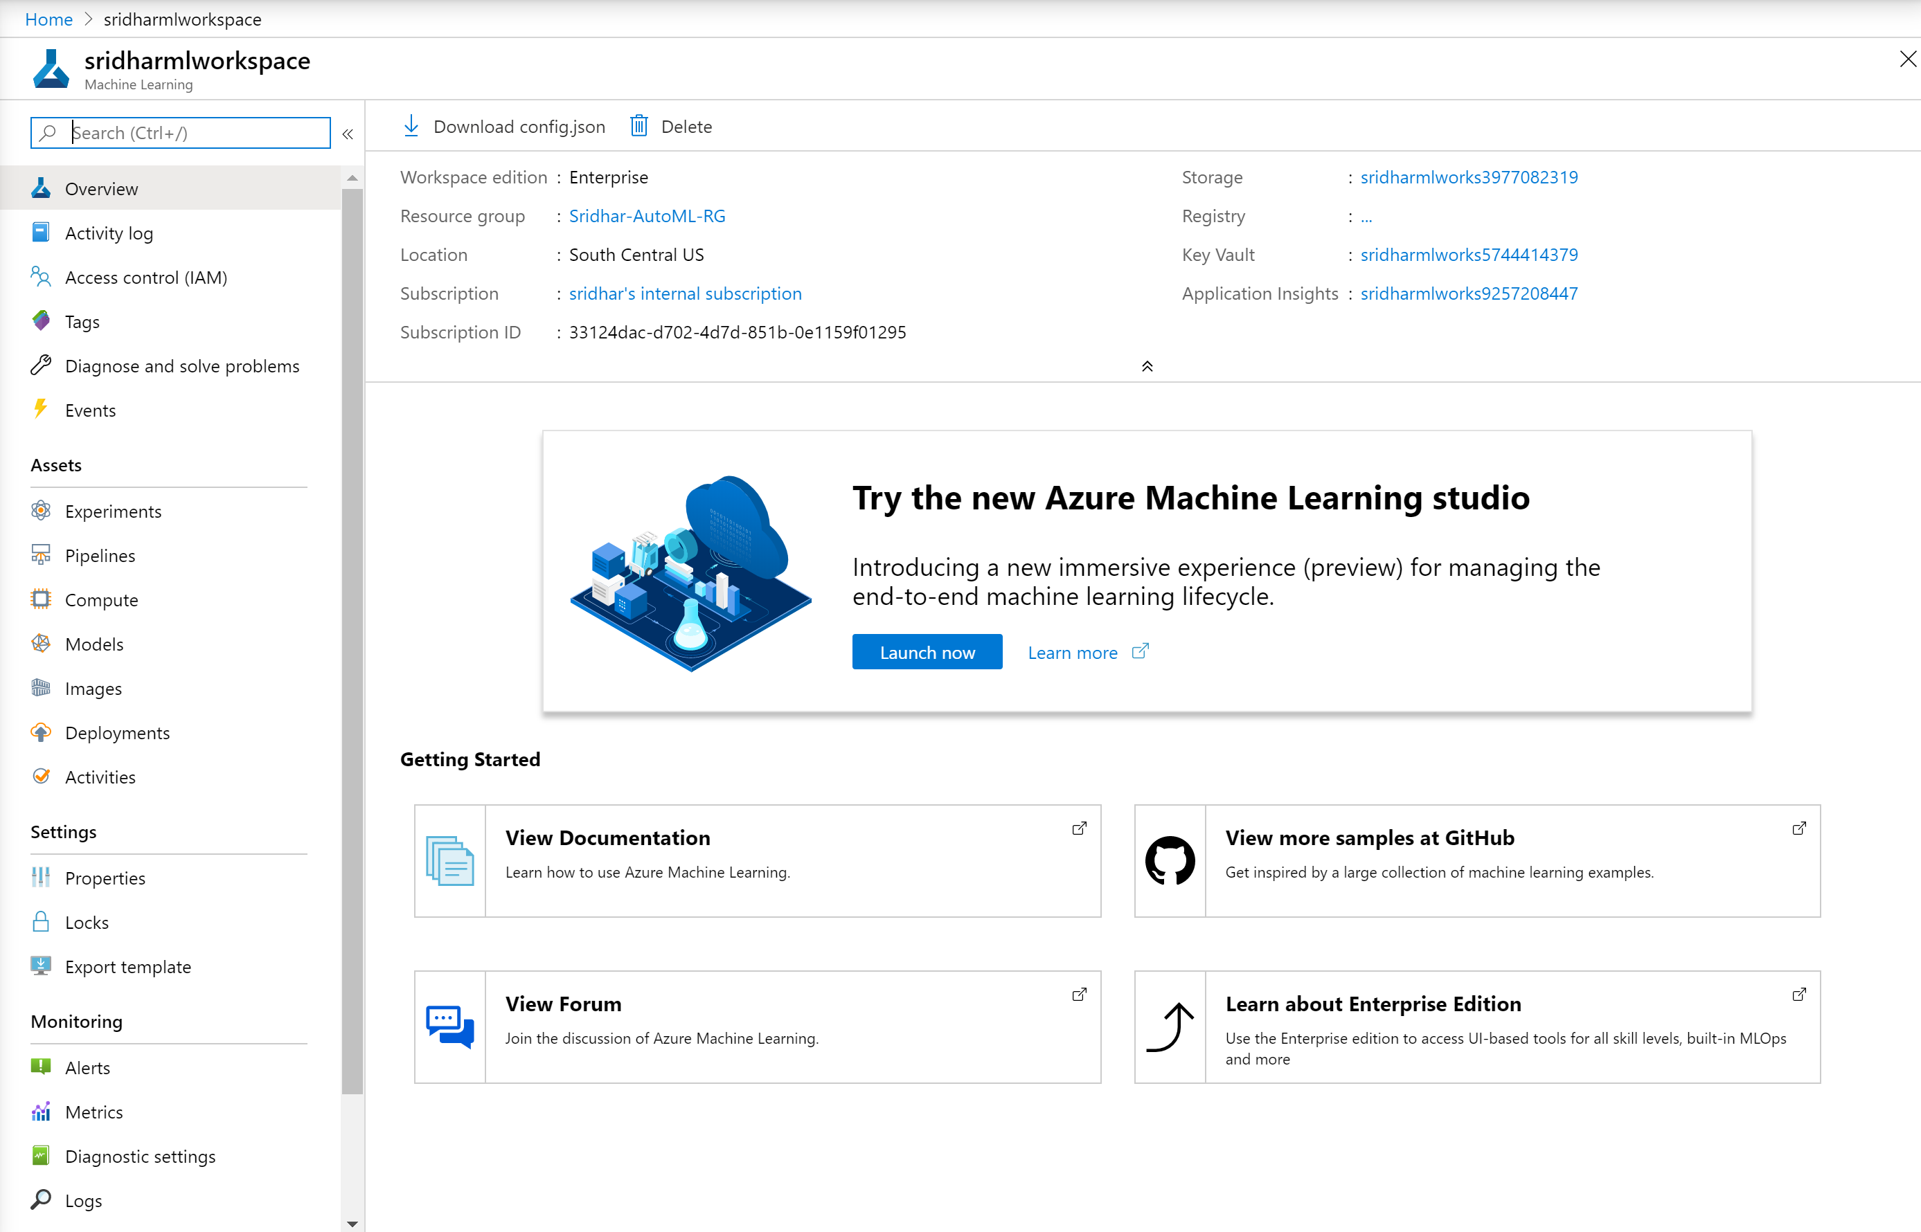
Create a Machine Learning workspace
1
2
3

Slide 6
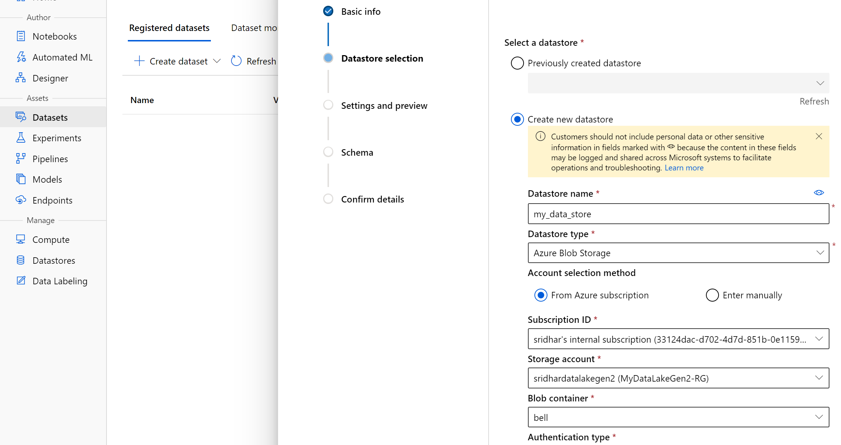
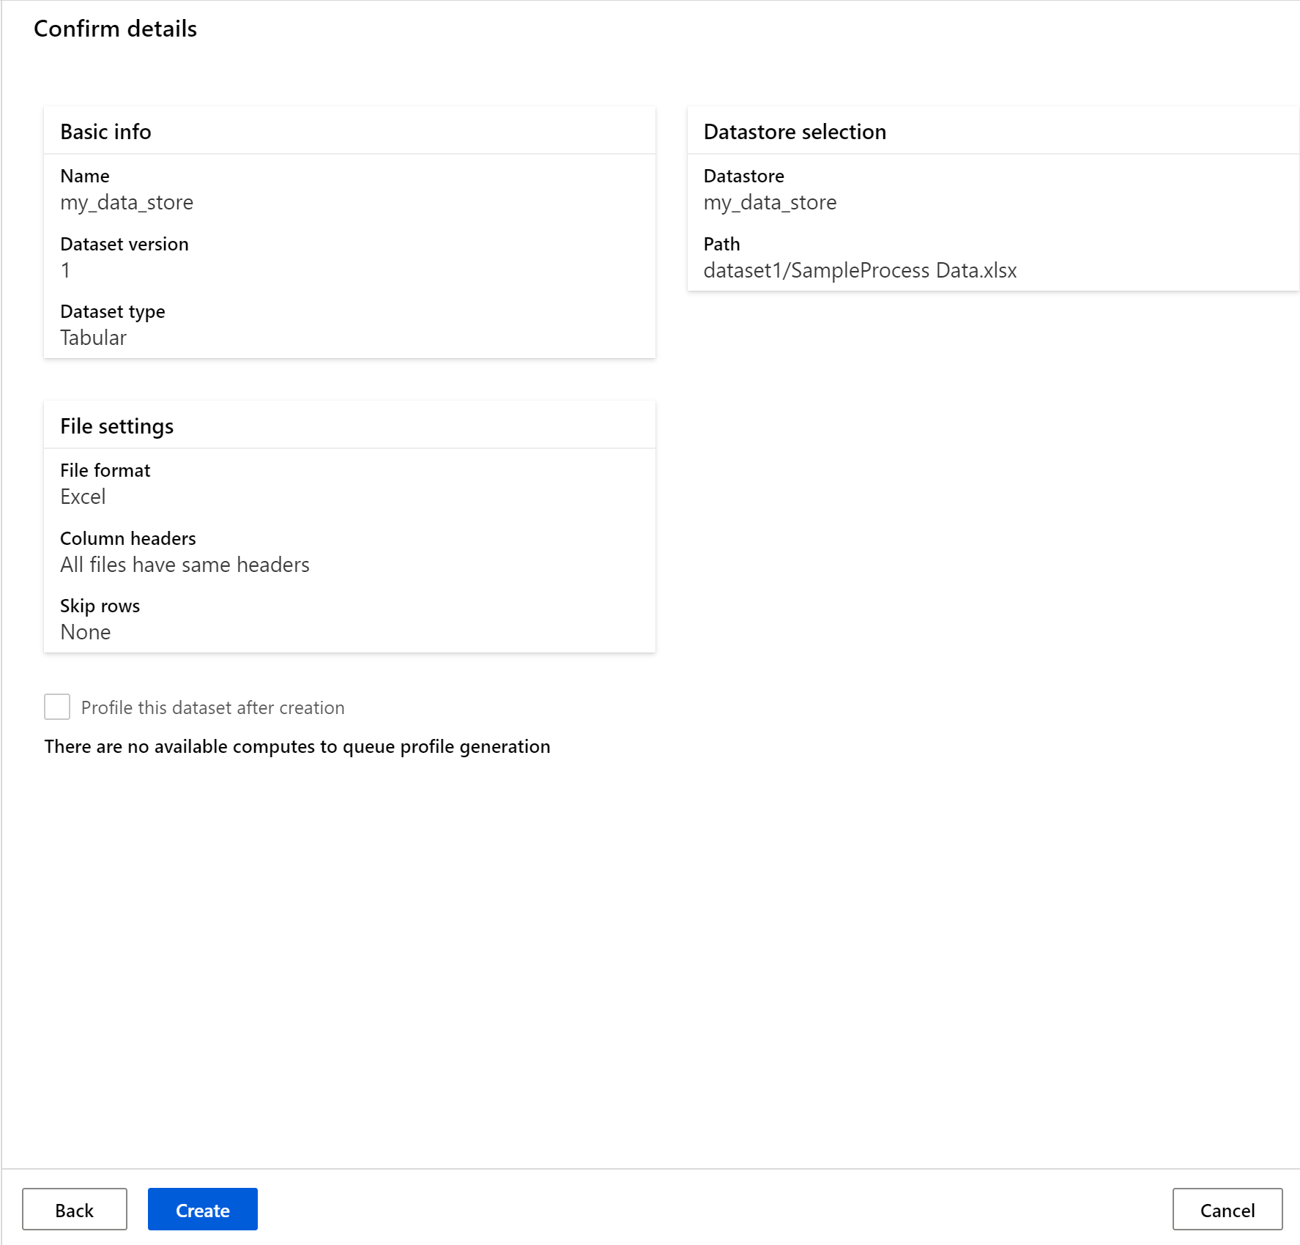
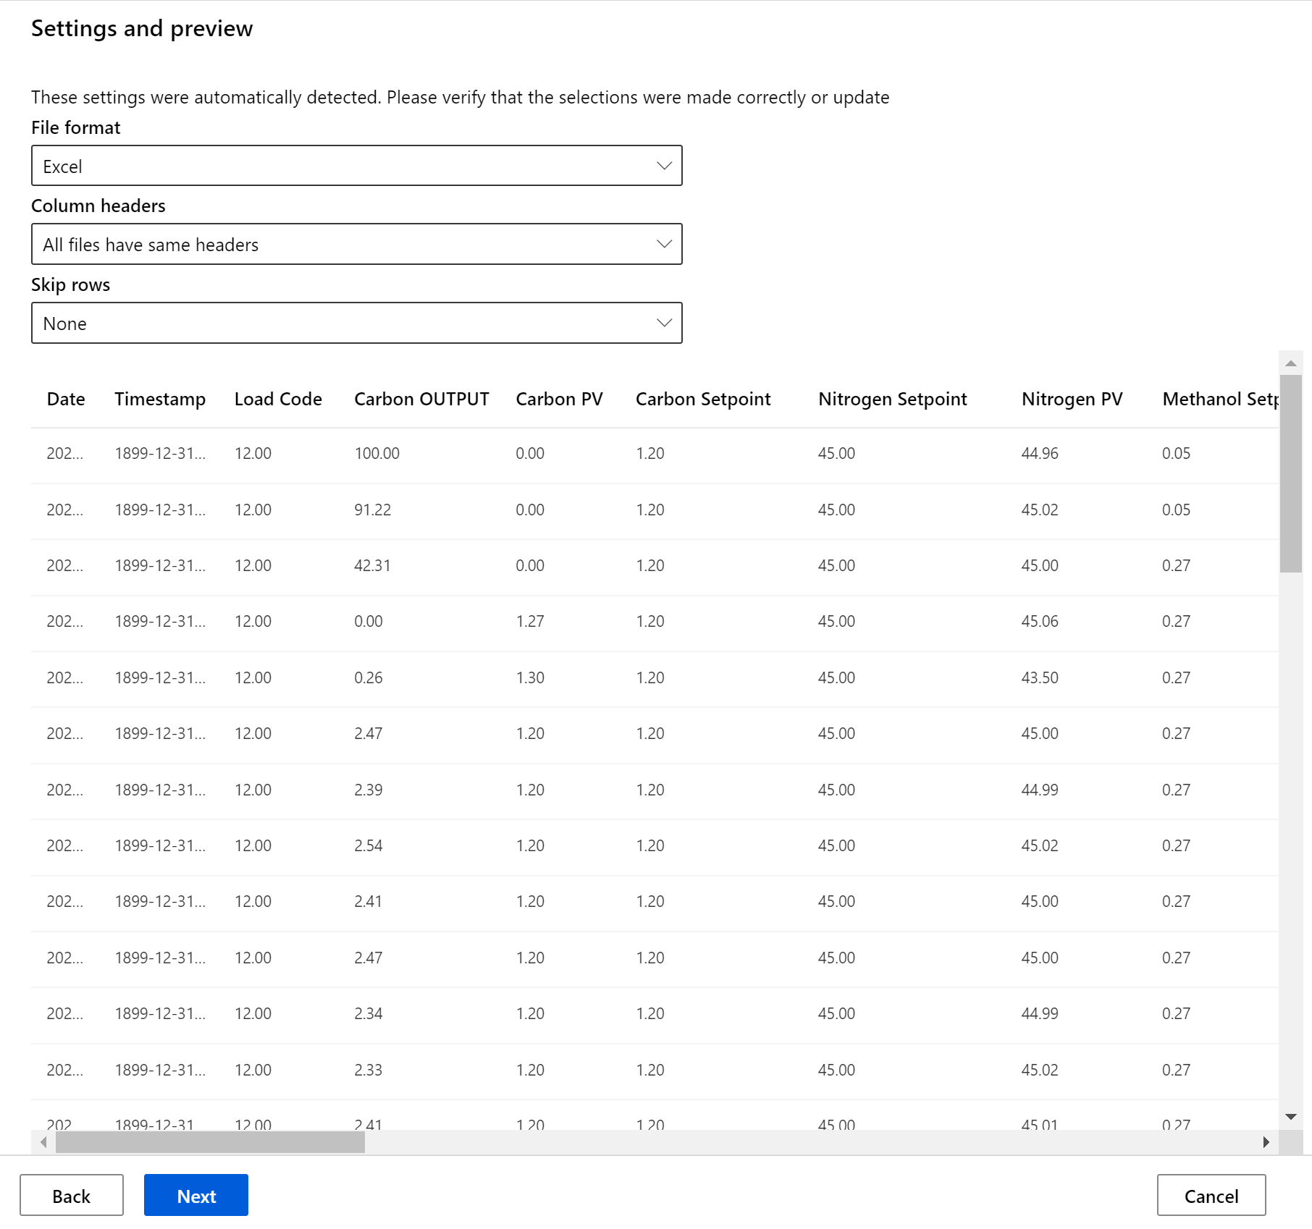
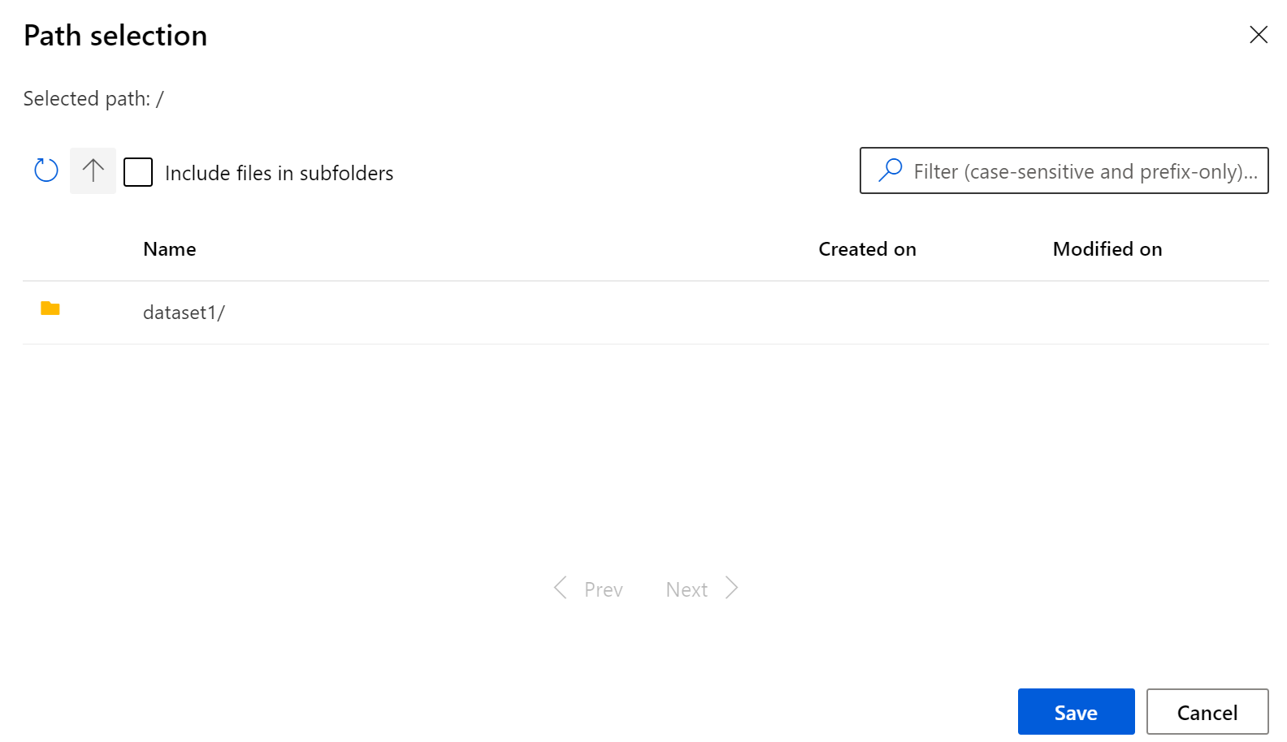
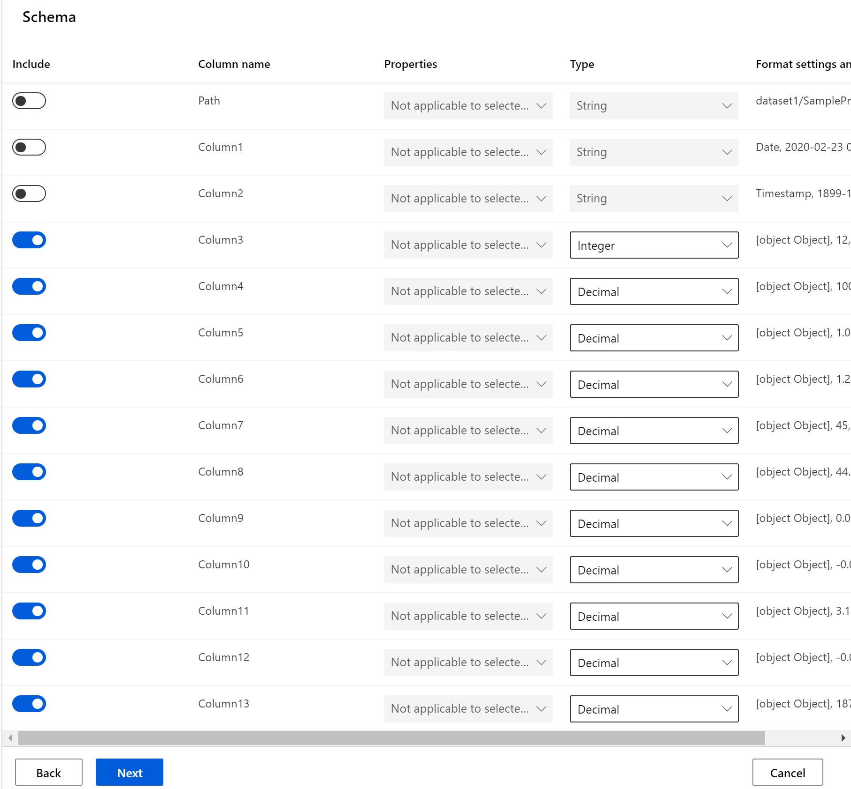
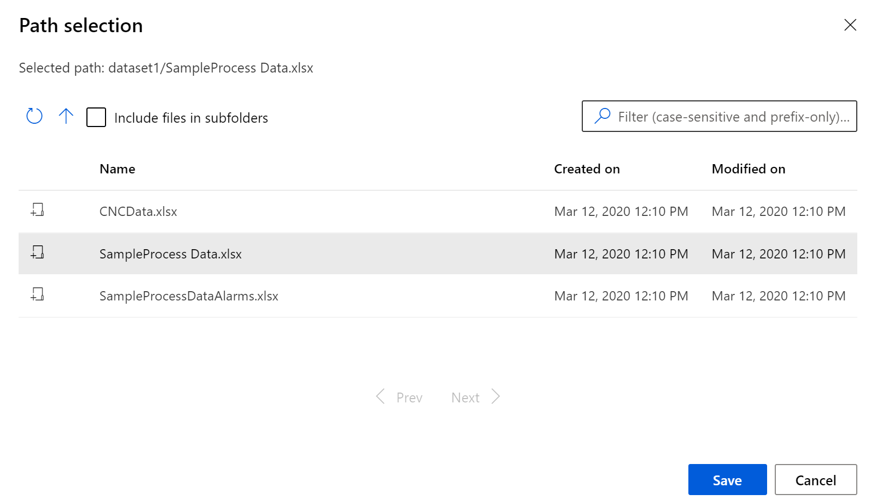
Create a Dataset
1
4
5
2
6
3

Slide 7
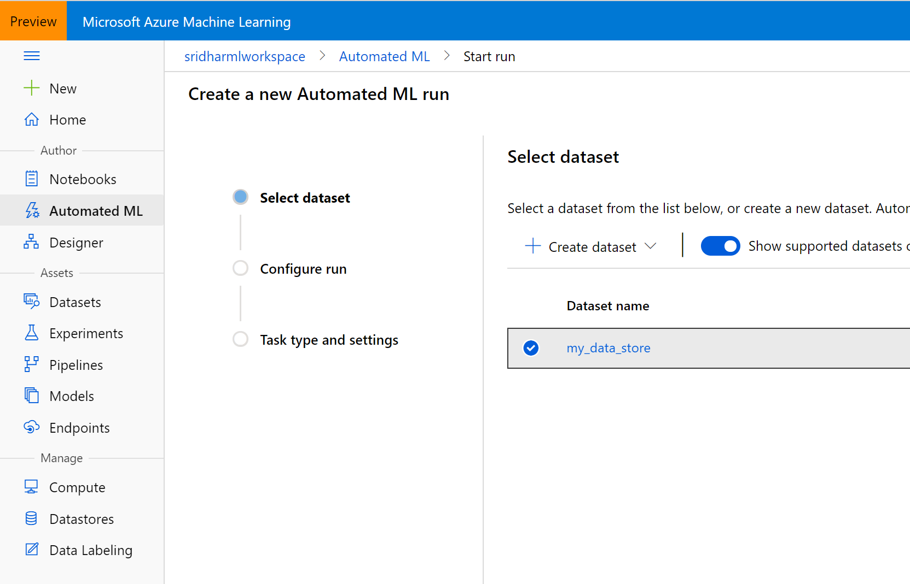
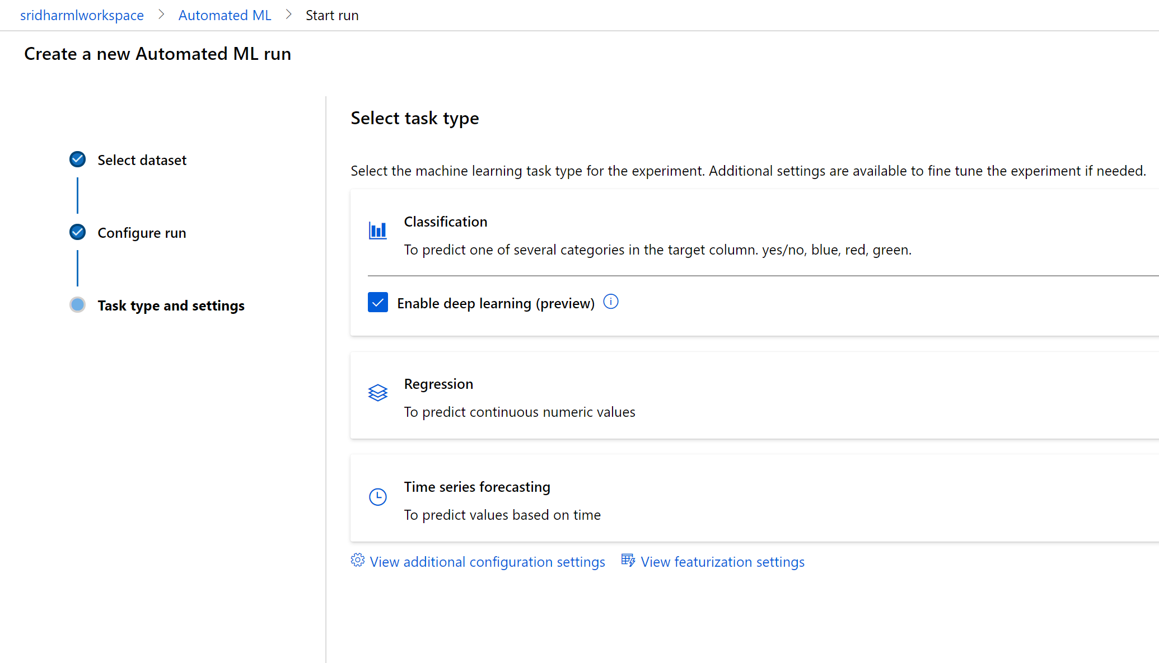
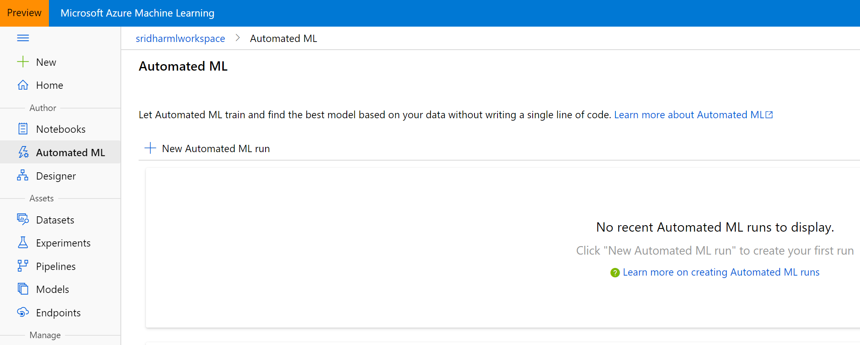
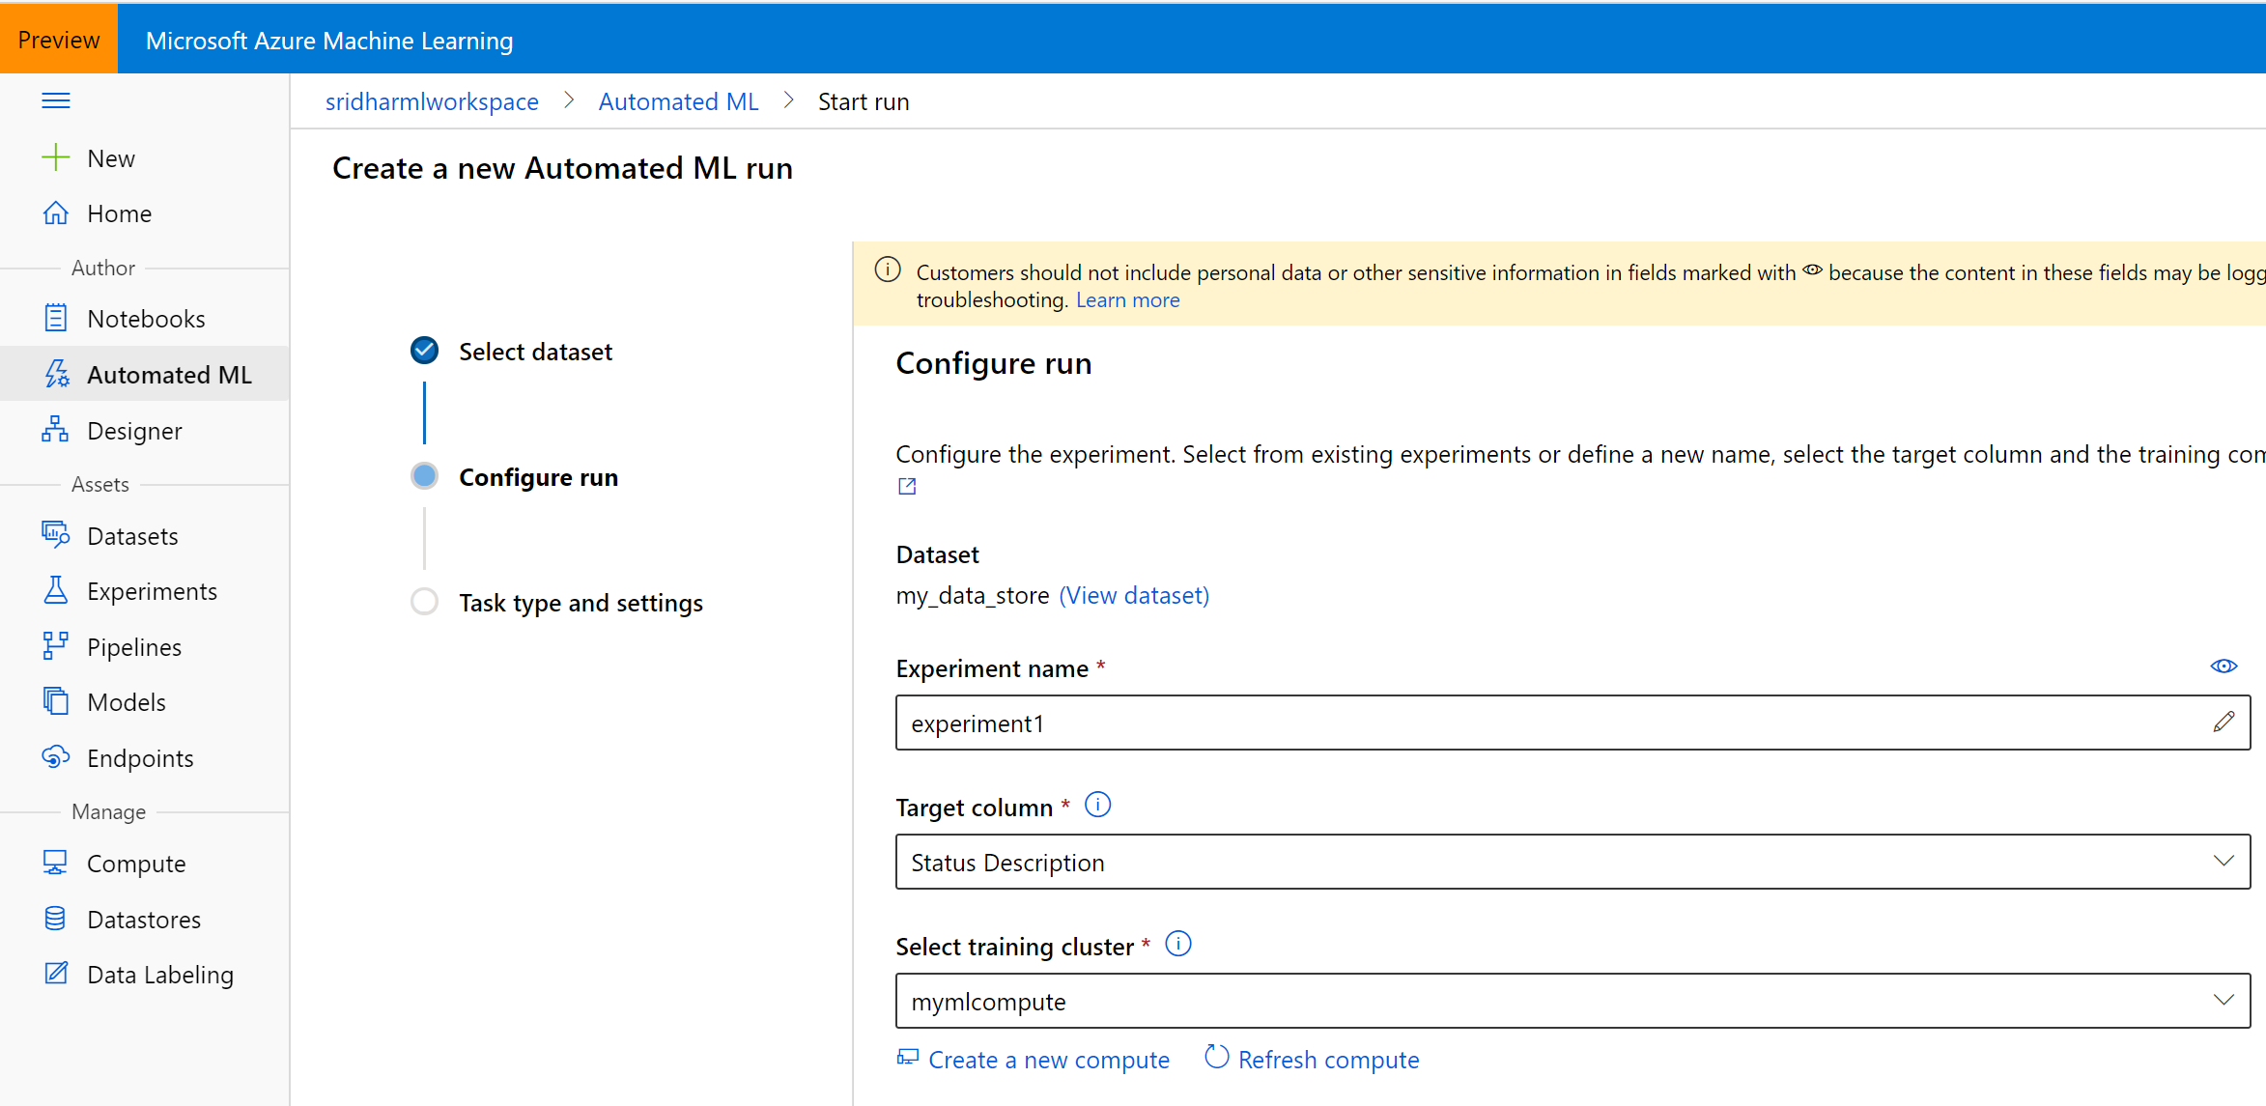
Create an Auto ML run
3
4
1
2

Slide 8
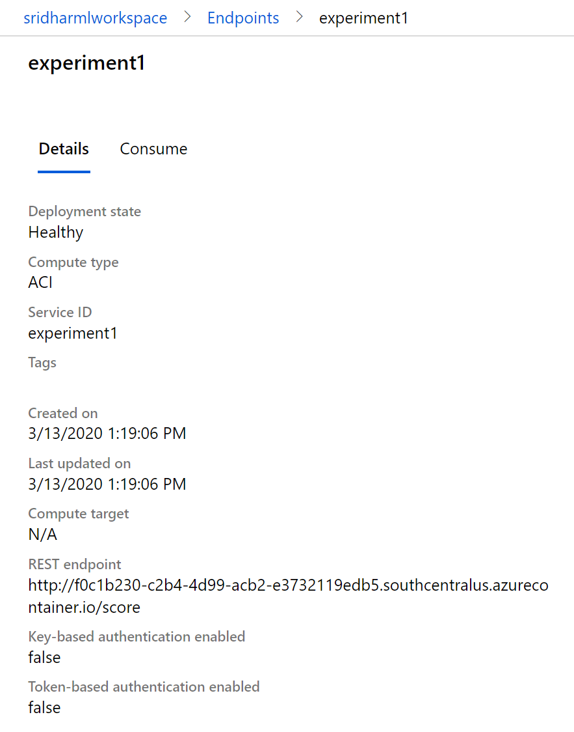
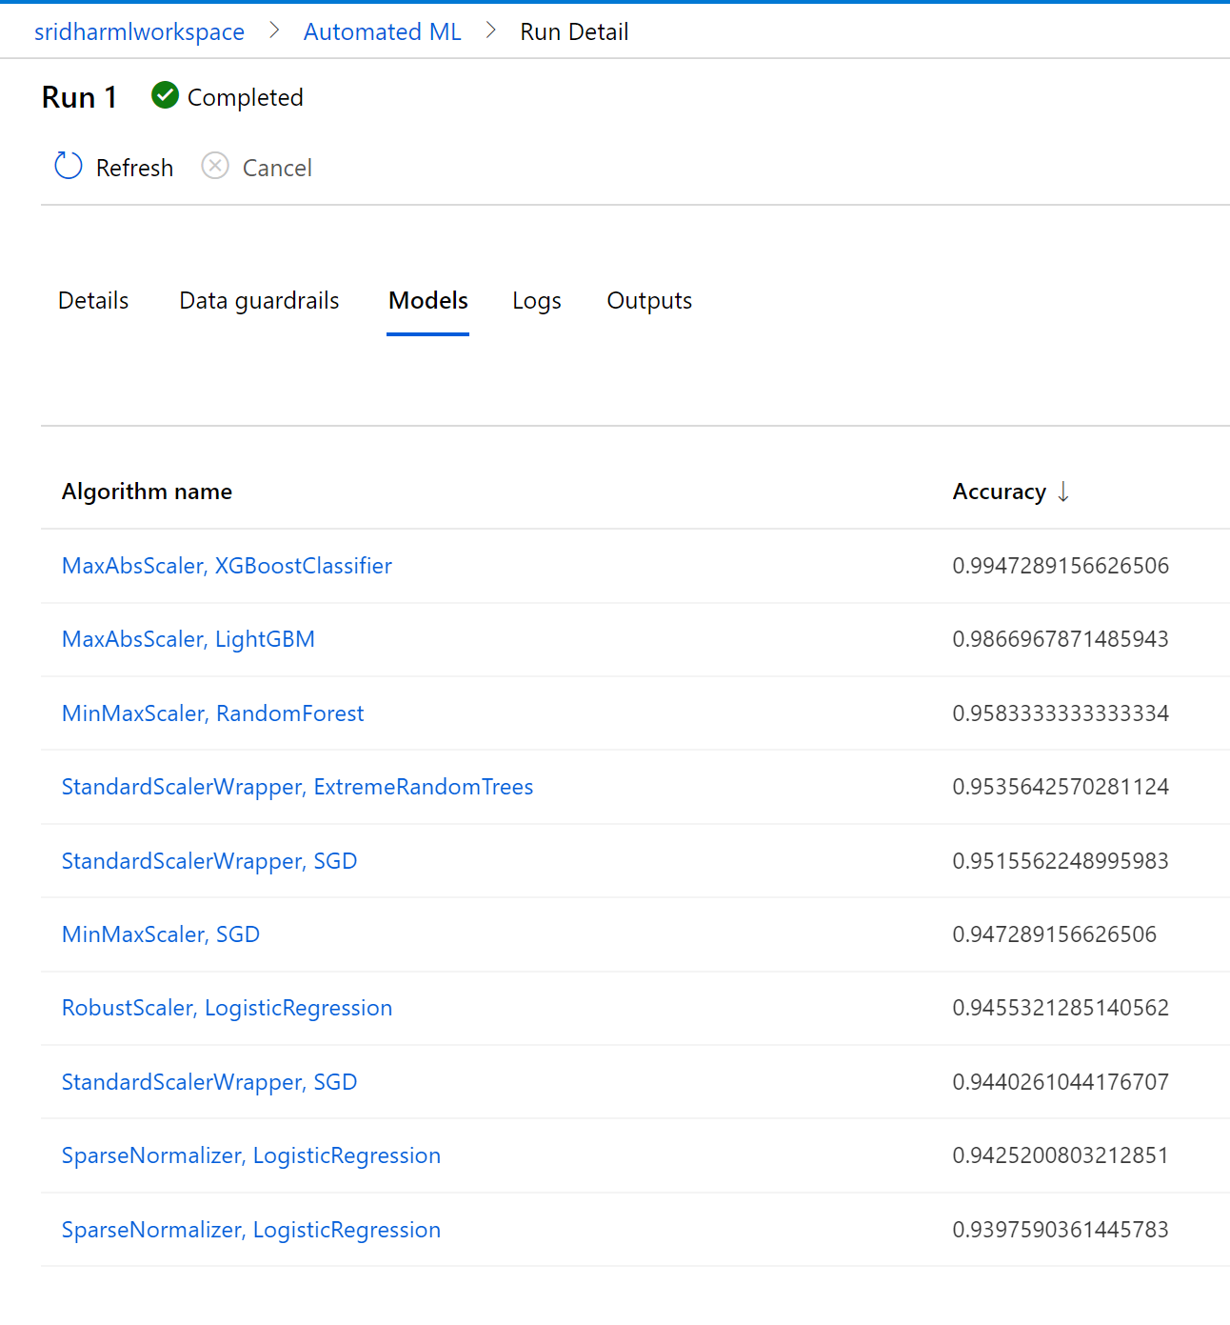
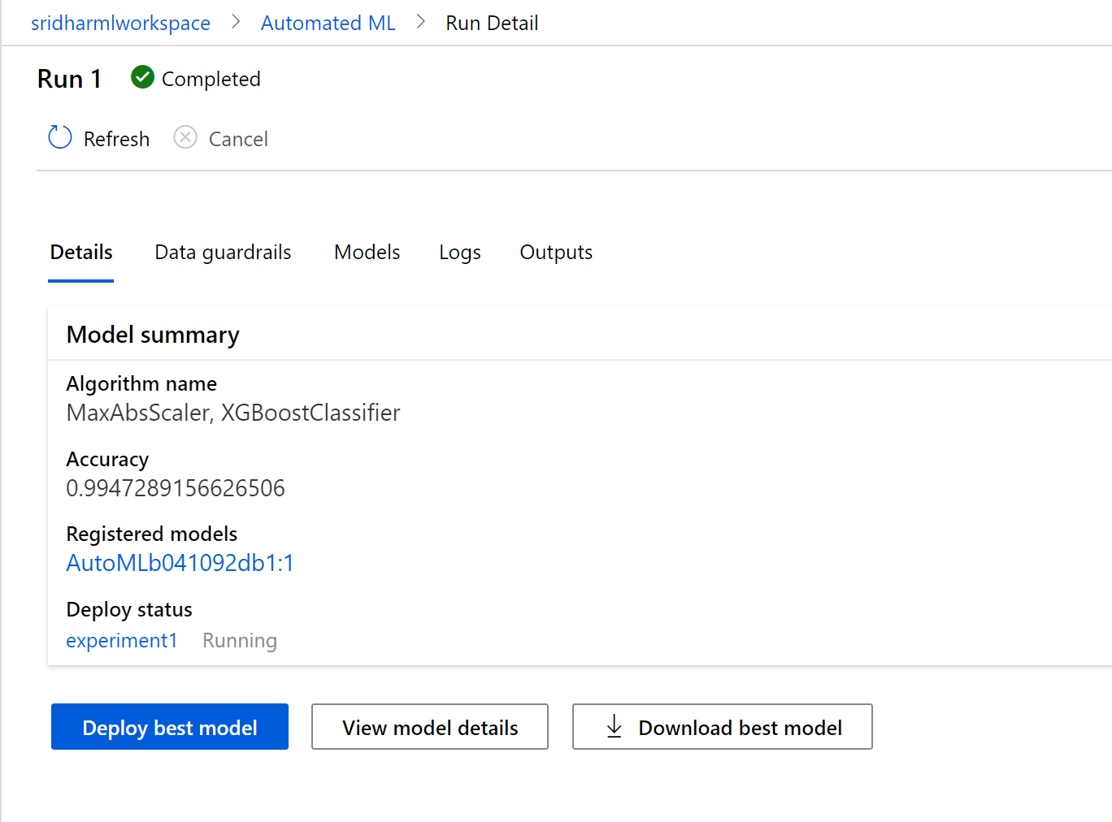
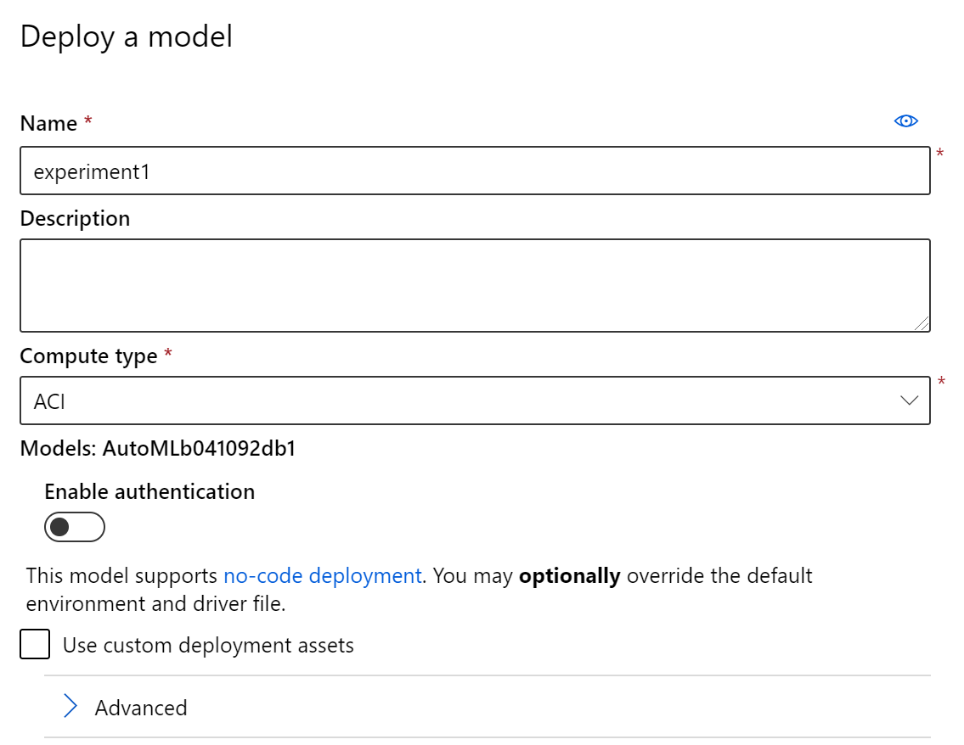
Deploy the best model
1
2
3
4

Slide 9
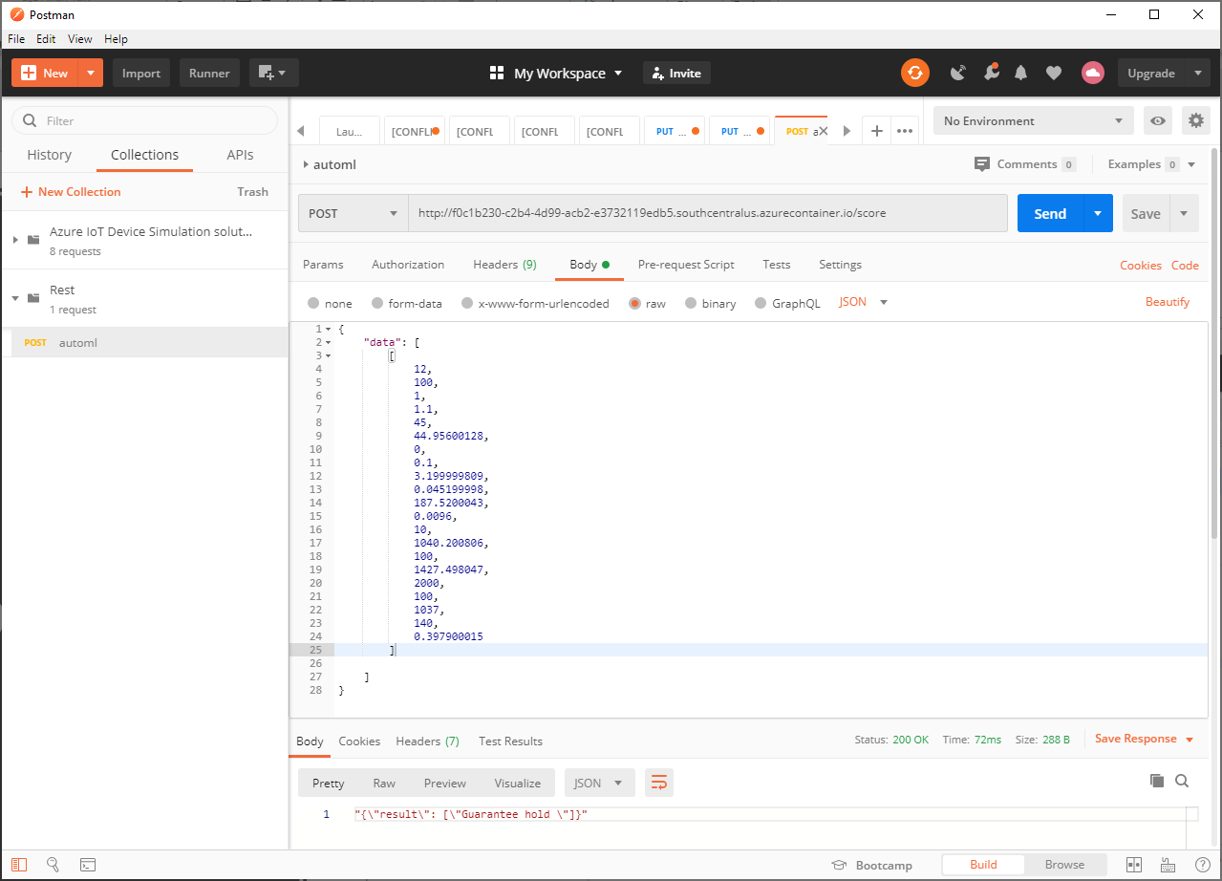
Score

Slide 10
Thank You

